Slide 1

AI based
Coding Online Judge
Team 3 | “DevNavi”
권민성 안정민
서주원 이장엽
안서현 한수현

Slide 2


Contents
1 | Overview
2 | Methods
3 | Team
4 | Effect
ⓒSaebyeol Yu. Saebyeol’s PowerPoint

Slide 3

Project Overview
Part 1 |
ⓒSaebyeol Yu. Saebyeol’s PowerPoint

Slide 4

Part 1
Overview
What kind of AI service should we provide?
In coding education, enabling learners to understand the
1) given problem 2) code that they have written
are the 2 most important things.

Slide 5




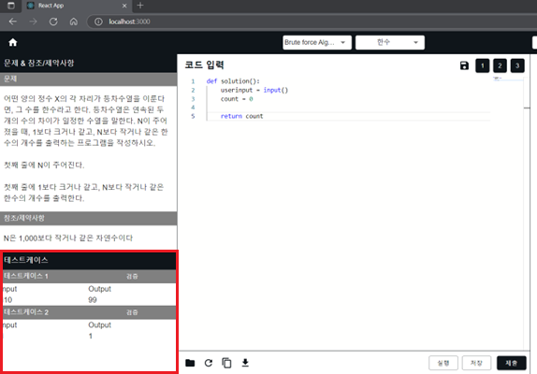

Part 1
Overview
DevNavi About us Curriculum My Page
DevNavi About us Curriculum My Page
DevNavi About us Curriculum My Page
My course
Code Editor
Test Result
DevNavi Anaylsis
Algorithm | Stage 1. What is --------------------?
DevNaviBot
Data structure
Algorithm
Problem
User Profile
Stage 1. What is --------------------------- ?
Print out this result by utilizing this function ---------------
Refer to this data in the video and make sure to include this in your code
Stage 2. What is --------------------------- ?
Test Case
Stage 3. What is --------------------------- ?
Test Case 1 |
Test Case 2 |
Test Case 3 |
Curriculum
Code Editor
AI-based Code Description
We are planning to provide a curriculum on algorithm and data structure in a sequence of
Video lecture
Coding test
Analysis on the code
DevNavi AI will analyze user code and provide feedback on error, code improvement
DevNaviBot will answer user’s coding related question
Our code editor will be consisted as above.
Left side – problem statement, test case
Right side – code editor (code save, copy, open file)
Understand
Coding Problem
Understand
Written Code

Slide 6
Part 1
Overview – User Flow
Main Page
Code Editor
DevNavi About us Curriculum My Page
DevNavi About us Curriculum My Page
My course
Code Editor
Landing Page
Algorithm | Stage 1. What is --------------------?
Data structure
Algorithm
Problem
Login Page
User Profile
Stage 1. What is --------------------------- ?
Print out this result by utilizing this function ---------------
Refer to this data in the video and make sure to include this in your code
Stage 2. What is --------------------------- ?
Test Case
Stage 3. What is --------------------------- ?
Test Case 1 |
Test Case 2 |
Test Case 3 |
Additional Service
Evaluation Page
DevNavi About us Curriculum My Page
DevNavi About us Curriculum My Page
Test Result
DevNavi Anaylsis
Test Result
DevNavi Anaylsis
DevNaviBot

Slide 7

Methods
Part 2 |
ⓒSaebyeol Yu. Saebyeol’s PowerPoint

Slide 8




Part 2
Methods – Tech Stack
Front
web
HTML5
CSS
React
DOM library
JS

Slide 9



Part 2
Methods – Tech Stack
Back
TypeScript
MySQL - DB
NestJS
- Node backend framework

Slide 10



Part 2
Methods – Tech Stack
Common
Code tool
ChatGPT
API
eslint
Prettier

Slide 11
Team
Part 3 |
ⓒSaebyeol Yu. Saebyeol’s PowerPoint

Slide 12
Part 3
Team – Role
FRONT
BACK
권민성
안서현
서주원
안정민
한수현
이장엽

Slide 13
Part 3
Team – Schedule
 | ~ 3/17 | ~ 3/24 | ~ 3/31 | ~ 4/7 | ~ 4/14 | ~ 4/21 | ~ 4/28 | ~ 5/5 | ~ 5/12 | ~ 5/19 | ~ 5/26 | 6/2
Requirement specification
Design specification
Implement component
Integration
Test plan
Code review
Testing

Slide 14
Effect
Part 4 |
ⓒSaebyeol Yu. Saebyeol’s PowerPoint

Slide 15



Part 4
Effect
Users can understand
the concepts on
data structure, algorithm with well-set curriculum courses
With AI analysis,
Users can thoroughly analyze
the coding problem
and their own codes
With AI Chatbot,
Users can study conveniently
Related to coding materials

Slide 16
Thank you
Team 3 | “DevNavi”
권민성 안정민
서주원 이장엽
안서현 한수현

